Slide 1
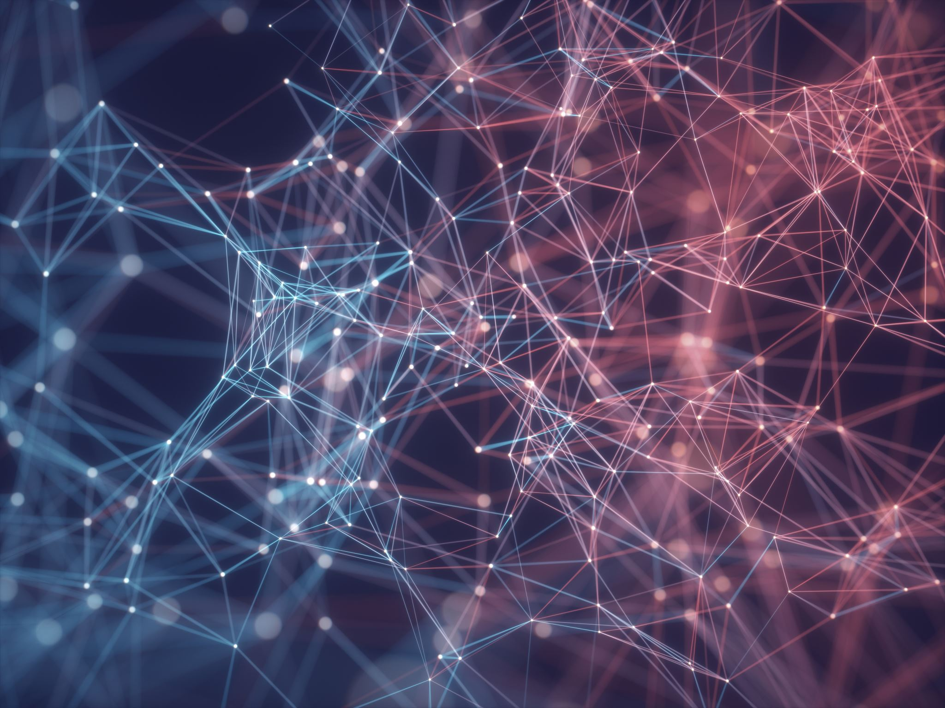
Image Captioning Using Deep Learning Techniques
By:
Dheeraj Talasila
Sai Sruthi Bodapati

Slide 2
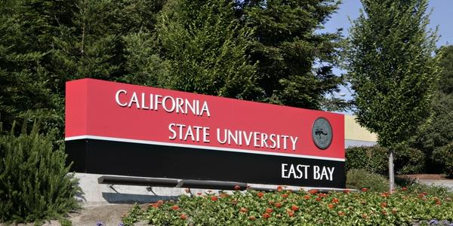
Introduction
What do you understand seeing this picture??
California sate university name board or California state university east bay sign board on small plants with flowers or name board with trees and plants etc..
All are related!!
Now can a computer understand this? Can computer take the image as input and gives caption as output?
Yes, it can be done using Deep learning models and AI.
How important is this problem in real life scenarios?
Aid to the blind — We can create a product for the blind which will guide them travelling on the roads without the support of anyone else. We can do this by first converting the scene into text and then the text to voice.
Image Captioning - It can help, make Google Image Search as good as Google Search, as then every image could be first converted into a caption and then search can be performed based on the caption.

Slide 3
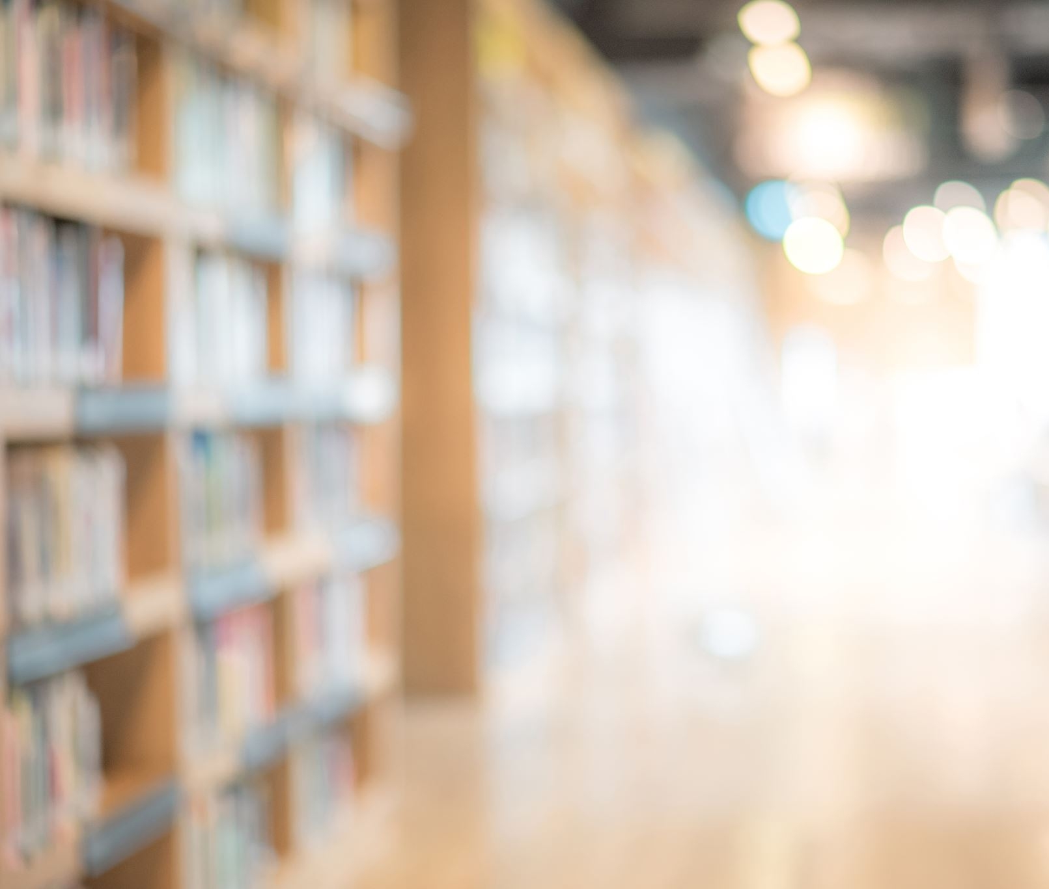
The main objective of this project is to generate the captions by just taking the image as an input and producing relative captions.

Slide 4

Data Collection
There are many open-source datasets available for this problem, like Flickr 8k (containing8k images), Flickr 30k (containing 30k images), MS COCO (containing 180k images), etc.
But for the purpose of this project, we have used the Flickr 8k dataset provided by the University of Illinois at Urbana-Champaign.
This dataset contains 8000 images each with 5 captions
These images are bifurcated as follows:
Training Set — 6000 images
Validation Set — 1000 images
Test Set — 1000 images

Slide 5

Concepts Used
Transfer Learning
Gradient Descent
Text Processing
Recurrent Neural Networks
Convolution Neural Networks
Bleu (Bilingual Evaluation Understudy) Score

Slide 6


Approach
Partial Captions
RNN
(LSTM)
Feed Forward Net word
Ending with a softmax
Image Vector
(Pre-processed)
Predicted word , next in the sequence of partial caption

Slide 7
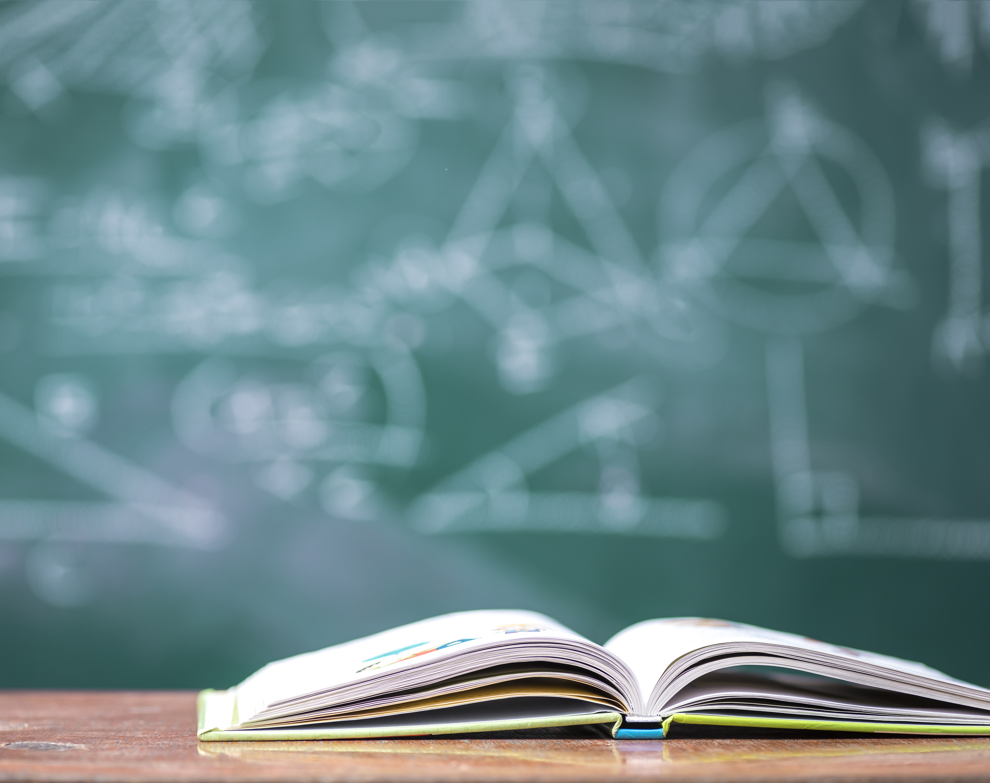
How to Model Image captioning
A captioning model relies on two main components, a CNN and an RNN.
Captioning is all about merging the two to combine their most powerful attributes i.e., CNNs (Convolutional Neural Networks) preserving spatial information and recognize objects in images. RNNs (Recurrent Neural Networks) work well with any kind of sequential data, such as generating a sequence of words.
So, by merging the two, we can get a model that can identify patterns from images, and then use that information to help generate a description of those images.

Slide 8
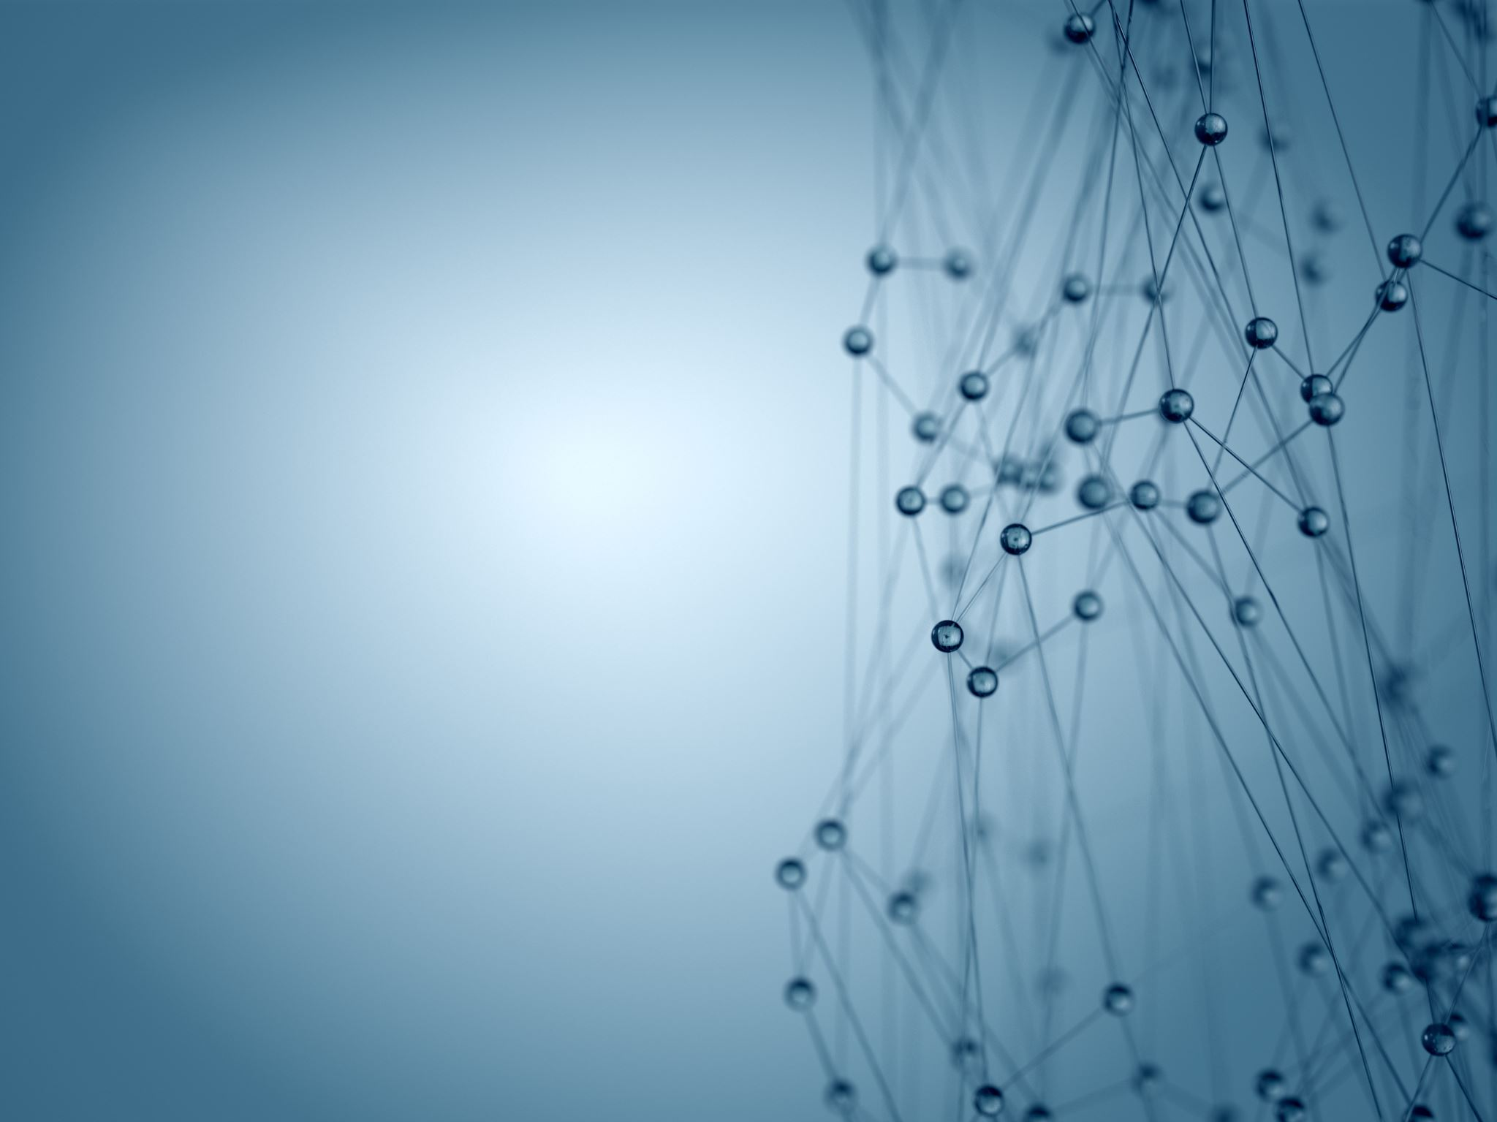
CNN & RNN
CNN : Convolutional Neural Network
These are designed to map image data to an output variable. They have proven so effective that they are the go-to method for any type of prediction problem involving image data as an input.
RNN : Recurrent Neural Network
RNN and LSTMs have received the most success when working with sequences of words and paragraphs, generally called natural language processing. This includes both sequences of text and sequences of spoken language represented as a time series.

Slide 9
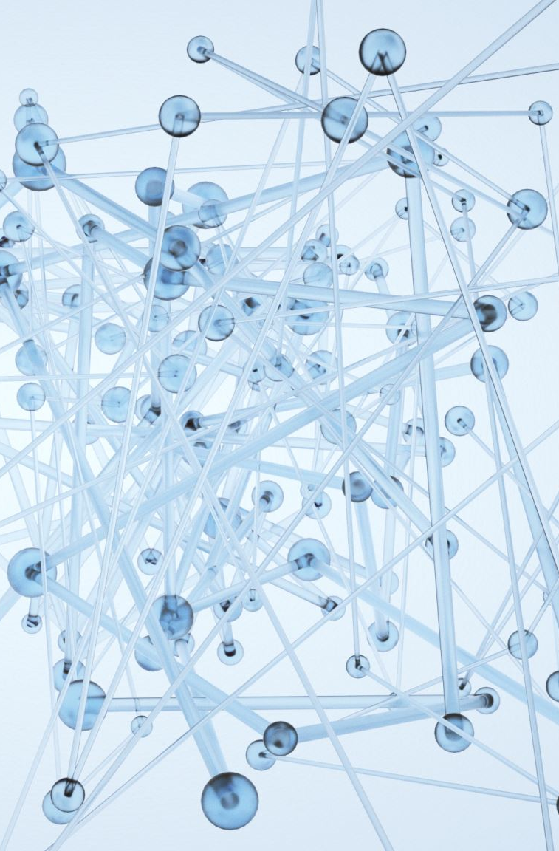
Data Pre-Processing
Images:
We need to convert every image into a fixed sized vector which can then be fed as input to the neural network.
We opted for transfer learning using Restnet50
RestNet-50 is a convolutional neural network that is 50 layers deep. We can load a pretrained version of the network trained on more than a million images from the ImageNet database . The pretrained network can classify images into 1000 object categories, such as keyboard, mouse, pencil, and many animals. As a result, the network has learned rich feature representations for a wide range of images. The network has an image input size of 224-by-224.

Slide 10
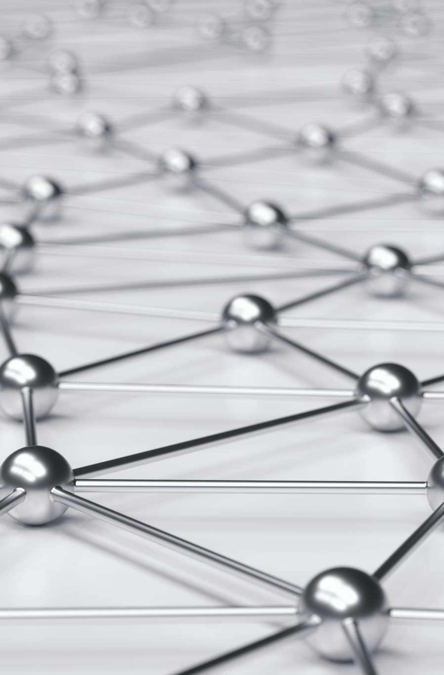
Data Pre-Processing
Data Preprocessing — Captions:
Here, the captions are the one we want to predict. So, during the training period, captions will be the target variables (Y) that the model is learning to predict.
But the prediction of the entire caption, given the image does not happen at once. We will predict the caption word by word. Thus, we need to encode each word into a fixed sized vector.
Word to Index
Index to Word

Slide 11

Model Explanation

Slide 12
Model-1

Slide 13
Model-2

Slide 14

Output of the model developed

Slide 15
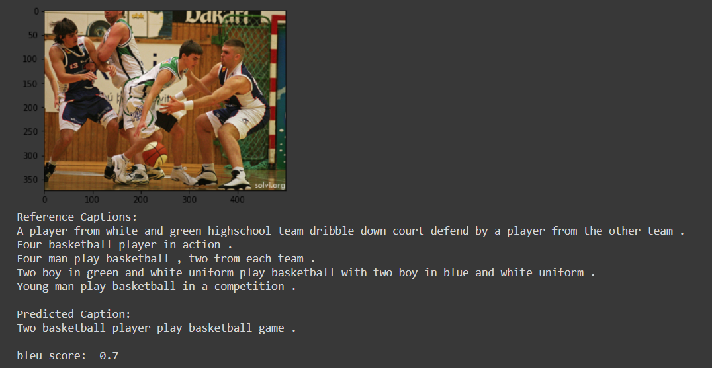
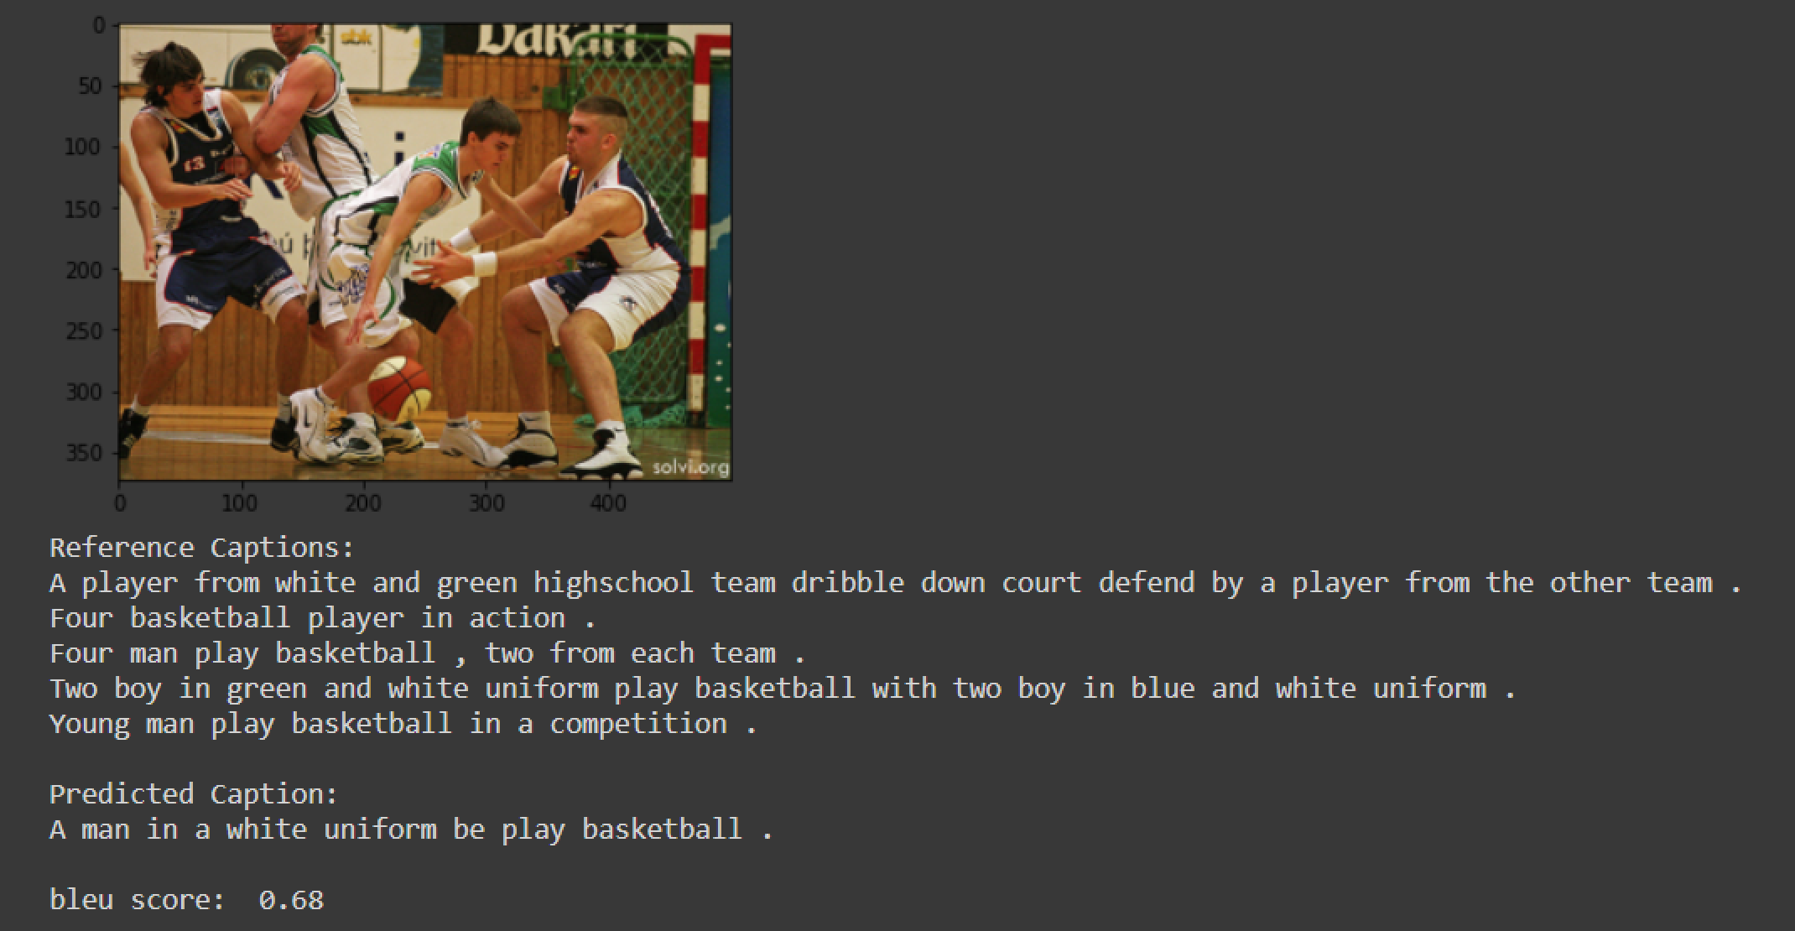
Model-1
Model-2

Slide 16
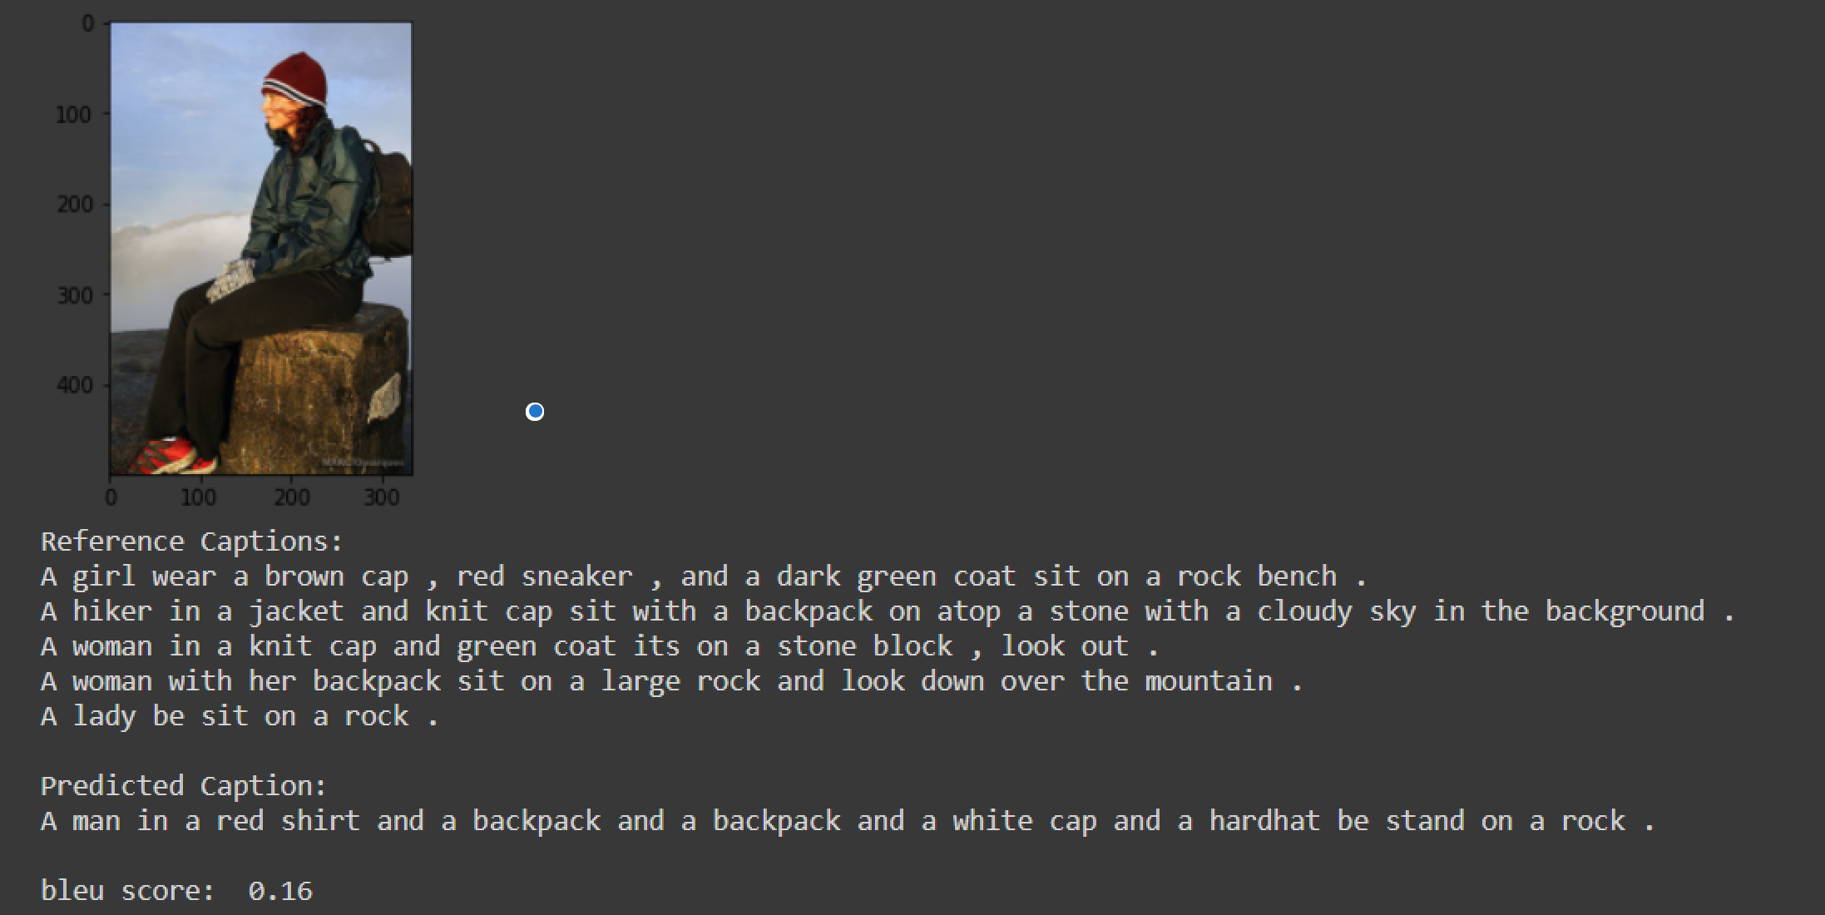
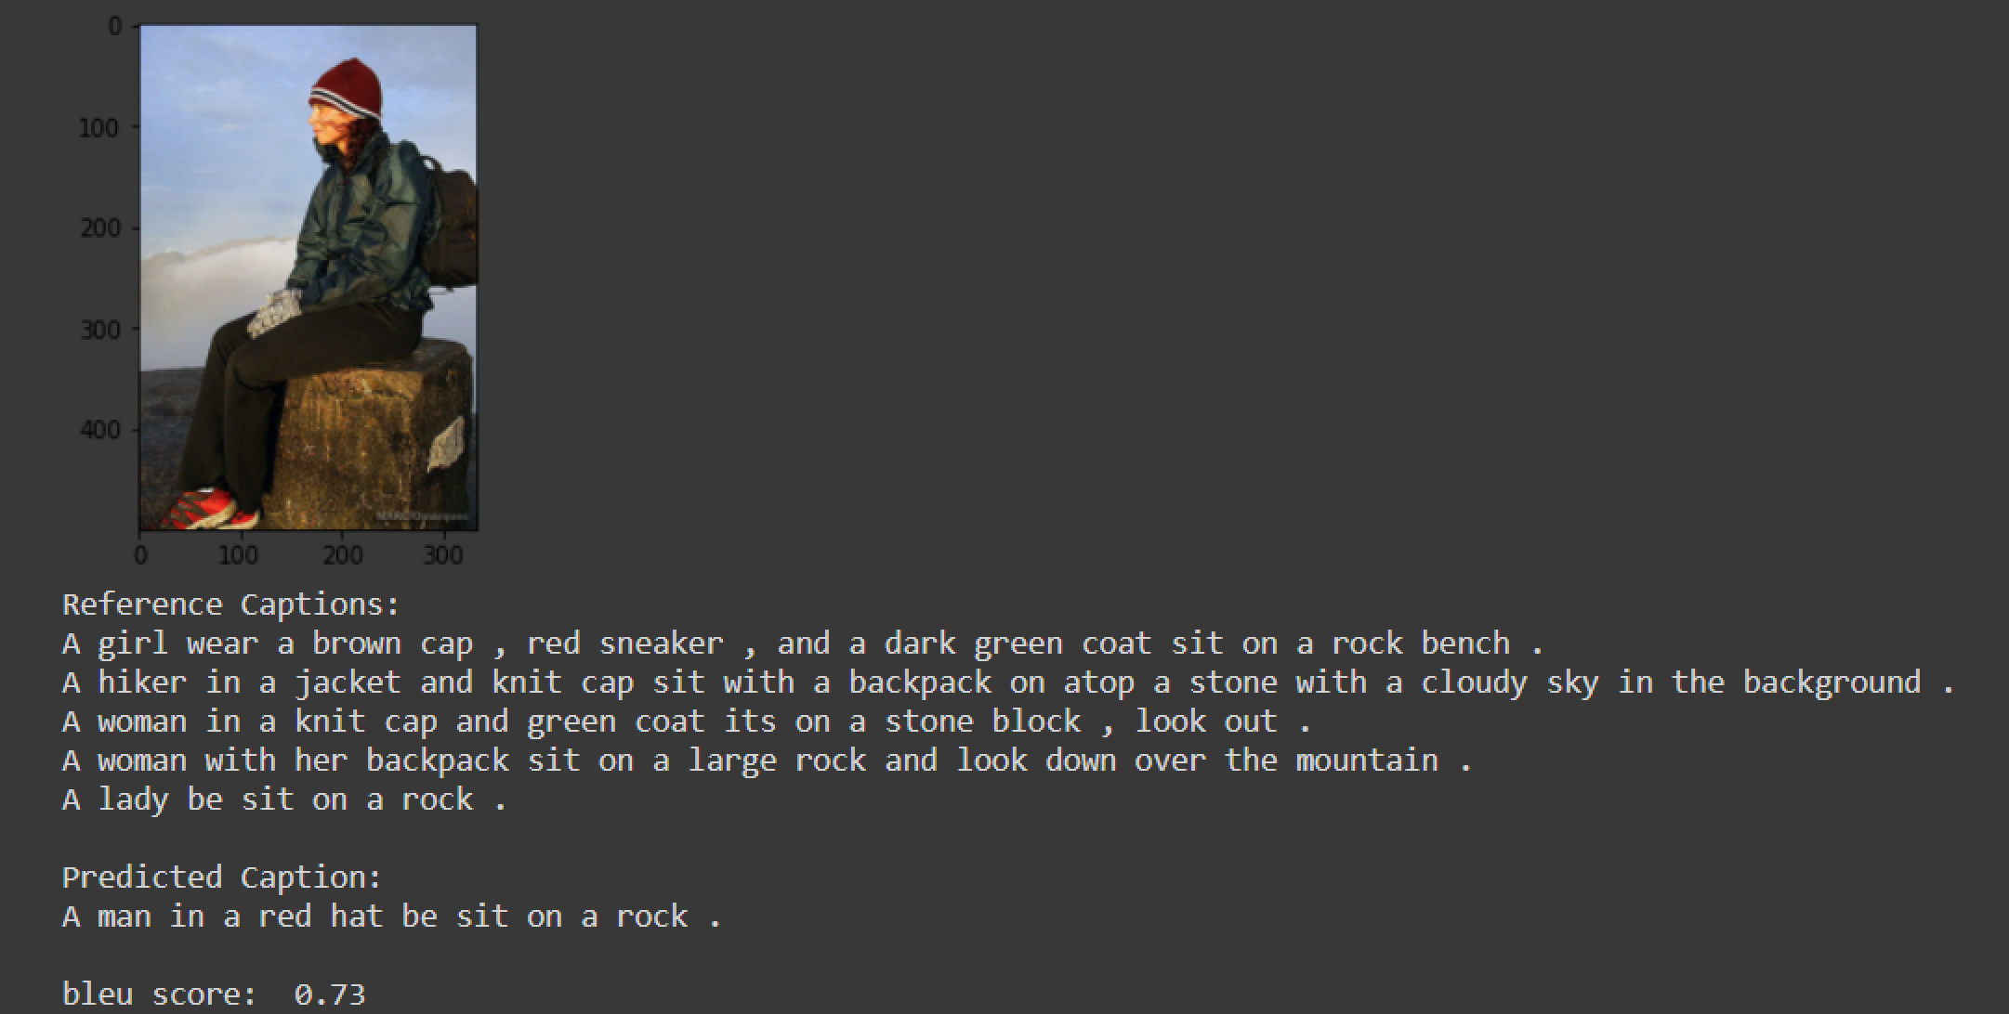
Model-1
Model-2

Slide 17
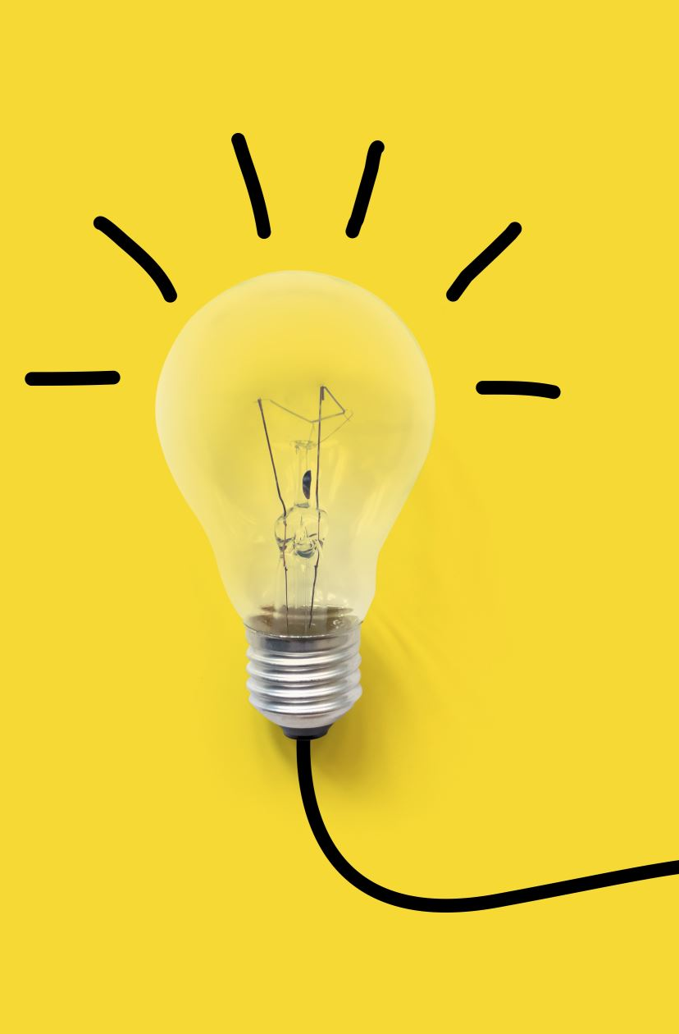
CONCLUSION
Using CNN and RNN we were able to effectively generate the captions for the testing images.
Potential Improvements:
1.Generating grammatically accurate captions
2.Generating as clear captions as possible and consistent to the image
Note: We understood that the images used for testing must be semantically related to those used for training the model. For example, if we train our model on the images of cats, dogs, etc. we must not test it on images of air-planes, waterfalls, etc.

Slide 18
Thank you

